Slide 1
Design Patterns
Unit 15
The Bridge and FlyWeight Pattern

Slide 2
Objectives
In this lesson, you will learn to:
The Bridge and FlyWeight Pattern

Slide 3
The Bridge Pattern
Intent
  Decouple an abstraction from its implementation so that the two can vary independently.
Motivation
  要做到“抽象(接口)与实现分离”，最常用的办法是定义一个抽象类，然后在子类中提供实现。也就是说，用继承机制达到“抽象(接口)与实现分离”
  但是这种方法不够灵活，继承机制把实现与抽象部分永久地绑定起来，要想独立地修改、扩展、重用抽象(接口)与实现都非常困难。
Aliases：Handle/Body

Slide 4
The Bridge Pattern
Applicability
Use the Bridge pattern when:
  You want to avoid a permanent binding between an abstraction and its implementation.
  Both the abstraction and their implementations should be extensible by subclassing.
  Changes in the implementation of an abstraction should have no impact on clients; that is, their code should not have to be recompiled.
  (C++) you want to hide the implementation of an abstraction completely from client.
  You want to share an implementation among multiple objects (perhaps using reference counting), and this fact should be hidden from the client.

Slide 5
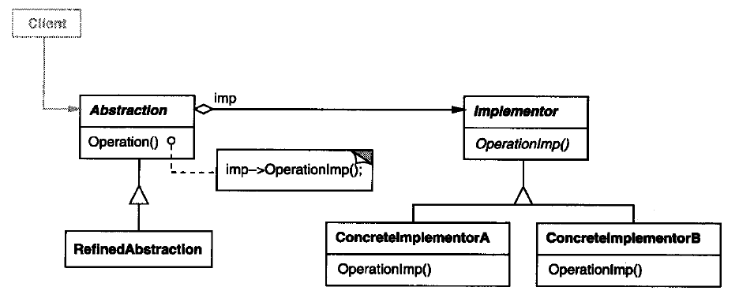
The Bridge Pattern
Structure

Slide 6
The Bridge Pattern
Participants
  Client,
  Abstraction, RefinedAbstraction, Implementor, ConcreteImplementor
Collaborations
  Abstraction forwards client requests to its Implementor object.

Slide 7
The Bridge Pattern
Consequences
  Decoupling interface and implementation. An implementation is not bound permanently to an interface. The implementation of an abstraction can be configured at run-time.
  Improved extensibility. You can extend the Abstract and Implementor hierarchies independently.
  Hiding implementation details from clients.

Slide 8
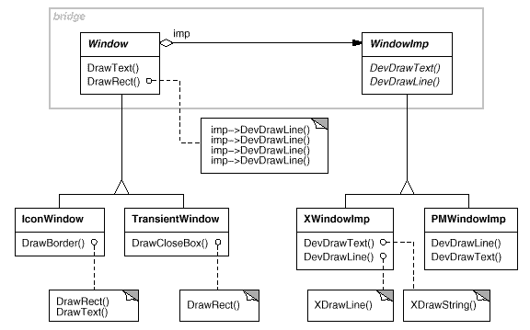
Bridge Pattern Example 1

Slide 9
FlyWeight Pattern
Intent
  Use sharing to support large numbers of fine-grained objects efficiently.
Motivation
  当对象的粒度太小的时候，大量对象将会产生巨大的资源消耗，因此考虑用共享对象(flyweight，即元类对象)来实现逻辑上的大量对象。Flyweight对象可用于不同的context中，本身固有的状态(intrinsic state)不会随context发生变化，而其他的状态(extrinsic state )随context而变化

Slide 10
FlyWeight Pattern
Applicability：Use the FlyWeight pattern when all of the following are true:
  An application uses a large number of objects.
  Storage costs are high because of the sheer quantity of objects.
  Most object state can be made extrinsic.
  Many groups of objects may be replaced by relatively few shared objects once extrinsic state is removed.
  The application doesn't depend on object identity. Since flyweight objects may be shared, identity tests will return true for conceptually distinct objects.

Slide 11
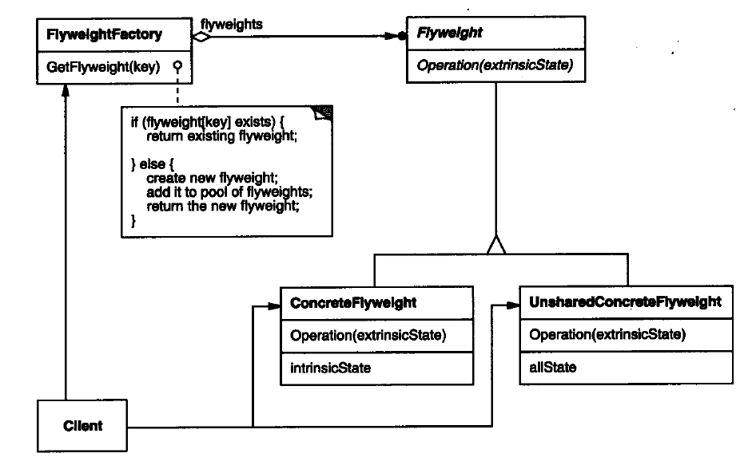
FlyWeight Pattern
Structure

Slide 12
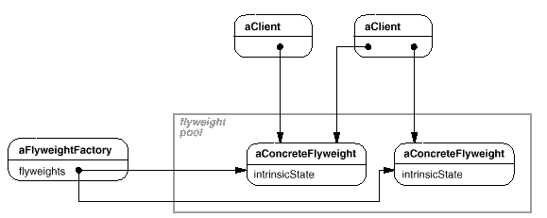
FlyWeight Pattern
Structure

Slide 13
FlyWeight Pattern
Participants
  Client, Flyweight, ConcreteFlyweight, FlyweightFactory,
  UnsharedConcreteFlyweight.
Evaluation
  把对象的状态分开：intrinsic and extrinsic
  节约存储空间：内部状态的共享节约了大量空间，外部状态可通过计算获得从而进一步节约空间
  flyweight与composite结合。Flyweight为leaf节点，并且父节点只能作为外部状态
Implementation
  Removing extrinsic state，尽可能做到实时计算(通过一个小的数据结构)
  Managing shared objects，客户不能直接实例化flyweight，必须通过管理器，例如FlyweightFactory。
  flyweight的生命周期管理，引用计数和回收。

Slide 14
FlyWeight Pattern
public interface Flyweight {
public void operation( ExtrinsicState state );
}
public class ConcreteFlyweight implements Flyweight {
private IntrinsicState state;
public void operation( ExtrinsicState state) { //… }
}
public class UnsharedConcreteFlyweight implements Flyweight {
private ExtrinsicState state;
public void operation( ExtrinsicState state ) {//… }
}

Slide 15
FlyWeight Pattern
public class FlyweightFactory { //Flyweight pool
private Hashtable flyweights = new Hashtable();
public Flyweight getFlyweight( Object key ) {
Flyweight flyweight = (Flyweight) flyweights.get(key);
if( flyweight == null ) {
//Creats new a ConcreteFlyweight object
flyweight = new ConcreteFlyweight();
flyweights.put( key, flyweight );
}
return flyweight;
}
}

Slide 16
Summary
The Bridge and FlyWeight Pattern

